Slide 1
Software Reliability

Slide 2
Software Reliability
Basic Concepts
There are three phases in the life of any hardware component i.e., burn-in, useful life & wear-out.
In burn-in phase, failure rate is quite high initially, and it starts decreasing gradually as the time progresses.
During useful life period, failure rate is approximately constant.
Failure rate increase in wear-out phase due to wearing out/aging of
components. The best period is useful life period. The shape of this curve is like a “bath tub” and that is why it is known as bath tub curve. The “bath tub curve” is given in Fig.7.1.
2

Slide 3
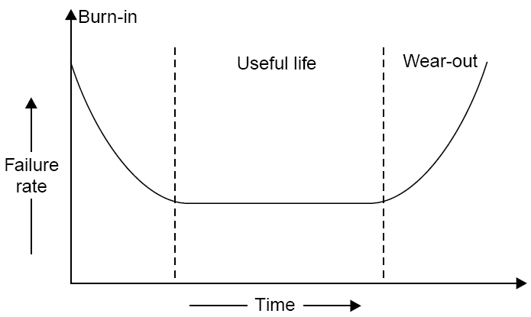
Software
Reliability
Fig. 7.1: Bath tub curve of hardware reliability.
3

Slide 4
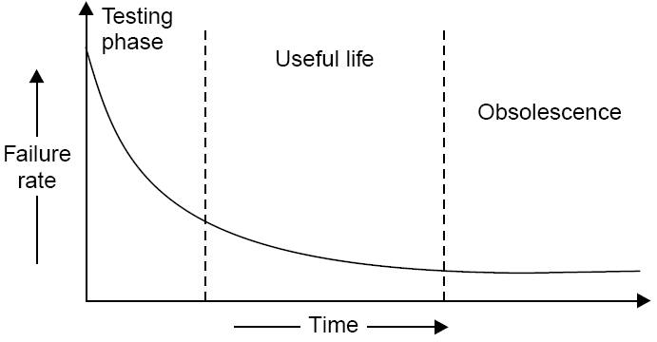
Software Reliability
We do not have wear out phase
in
software.
The
expected
curve
for
software
is
given
in
fig.
7.2.
Fig. 7.2:
Software reliability curve (failure rate versus time)
4

Slide 5
Software Reliability
Software
may
be retired
only
if
it
becomes
obsolete.
Some
of
contributing factors are given below:
change in environment
change in infrastructure/technology
major change in requirements
increase in complexity
extremely difficult to maintain
deterioration in structure of the
slow execution speed
poor graphical user interfaces
code
5

Slide 6
Software Reliability
What is Software Reliability?
“Software
reliability
means
operational
reliability.
Who
cares
how
many bugs are in the program?
As per IEEE standard: “Software reliability is defined as the ability of
a
system
or
component
to
perform its
required
functions
under
stated conditions for a specified period of time”.
6

Slide 7
Software Reliability
Software reliability is also defined as the probability that a software
system
fulfills
its assigned
task in
a
given
environment
for
a
predefined number of input cases, assuming that the hardware and
the inputs are free of error.
“It is the
specified
probability of a failure free operation
time in a specified environment”.
of
a
program
for a
7

Slide 8
Software Reliability
•
Failures and Faults
A
fault
is
the
defect
in
the
program
that,
when
executed
under
particular conditions, causes a failure.
The execution time for a program is the time
that is actually spent by
a
processor in
executing
the
instructions
of
that
program.
The
second kind of time is
normally experience.
calendar
time.
It
is
the
familiar
time
that
we
8

Slide 9
Software Reliability
There
time:
are four general ways of characterising failure
occurrences
in
1.
time of failure,
2.
time interval between failures,
3.
cumulative failure experienced up to a given time,
4.
failures experienced in a time interval.
9

Slide 10
Software
Reliability
Failure Number
Failure Time (sec)
Failure interval (sec)
1
8
8
2
18
10
3
25
7
4
36
11
5
45
9
6
57
12
7
71
14
8
86
15
9
104
18
10
124
20
11
143
19
12
169
26
13
197
28
14
222
25
15
250
28
10

Slide 11
Software
Reliability
Time (sec)
Cumulative Failures
Failure in interval (30 sec)
30
3
3
60
6
3
90
8
2
120
9
1
150
11
2
180
12
1
210
13
1
240
14
1
Table 7.2: Failure based failure specification
11

Slide 12
Software
Reliability
Value of random variable (failures in time period)
Probability
Elapsed time t_{A} = 1 hr
Elapsed time t_{B} = 5 hr
0
0.10
0.01
1
0.18
0.02
2
0.22
0.03
3
0.16
0.04
4
0.11
0.05
5
0.08
0.07
6
0.05
0.09
7
0.04
0.12
8
0.03
0.16
9
0.02
0.13
Table 7.3: Probability distribution at times tA and tB
12

Slide 13
Software
Reliability
Value of random variable (failures in time period)
Probability
Elapsed time t_{A} = 1 hr
Elapsed time t_{B} = 5 hr
10
0.01
0.10
11
0
0.07
12
0
0.05
13
0
0.03
14
0
0.02
15
0
0.01
Mean failures
3.04
7.77
Table 7.3: Probability distribution at times tA and tB
13

Slide 14
Software Reliability
A random process whose probability distribution varies with time to
time is called non-homogeneous. Most failure
fit this situation. Fig. 7.3 illustrates the mean
processes during test
value and the related
failure
intensity
functions
at
time
tA
and
tB.
Note
that
the
mean
failures experienced increases from 3.04 to 7.77 between these two
points, while the failure intensity decreases.
Failure behavior is affected by two principal factors:
the number of faults in the software being executed.
the execution environment or the operational profile execution.
of
14

Slide 15
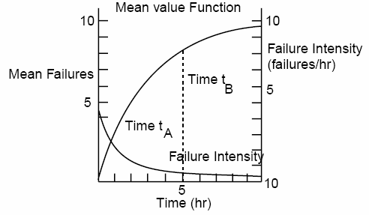
Software
Reliability
Fig. 7.3: Mean Value & failure intensity functions.
15

Slide 16
Software Reliability
Environment
The
environment is described
by the operational
profile.
The
proportion
of runs of various types may vary, depending on the
functional environment. Examples of a run type might be:
1.
a particular transaction in an airline reservation system
a business data processing system,
or
2.
a
specific cycle
in
a
closed
loop
control system
(for
example, in a chemical process industry),
3.
a particular service performed by an operating system
user.
for a
16

Slide 17
Software Reliability
The run types required of the program by the environment can be
viewed as being selected randomly. Thus, we define the operational profile as the set of run types that the program can execute along with possibilities with which they will occur. In fig. 7.4, we show two of many possible input states A and B, with their probabilities of occurrence.
The part of the operational profile for just these two states is
in fig. 7.5. A realistic operational profile is illustrated in fig.7.6.
shown
17

Slide 18
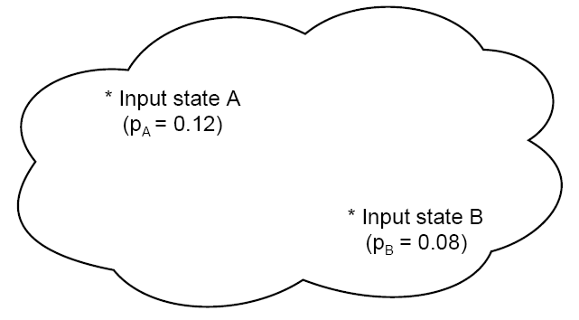
Software
Reliability
Fig. 7.4: Input Space
18

Slide 19
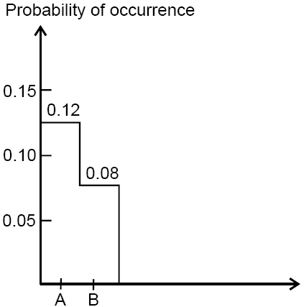
Software
Reliability
Fig. 7.5: Portion of operational profile
19

Slide 20
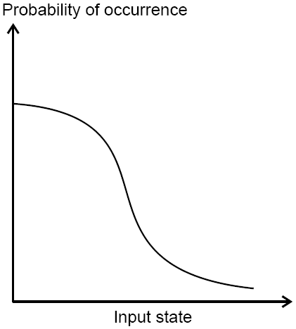
Software
Reliability
Fig. 7.6: Operational profile
20

Slide 21
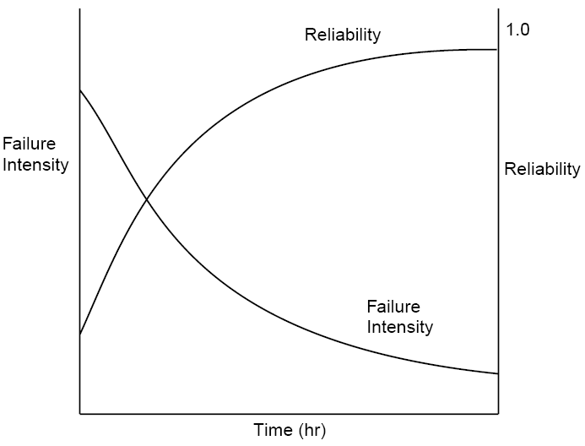
Software Reliability
Fig.7.7
during
shows
how
failure
intensity
and
reliability
typically
vary
a
test
period,
as
faults
are
removed.
Fig. 7.7: Reliability and failure
intensity
21

Slide 22
Software Reliability
Uses of Reliability Studies
There
are
at least four
other ways
in
which
software
engineer,
reliability
manager
measures can be of great value to the software
or user.
1.
you can use software reliability measures to evaluate
engineering technology quantitatively.
software
2.
software
evaluating project.
reliability
measures offer
you the possibility of
development
status
during
the
test
phases
of
a
22

Slide 23
Software Reliability
3.
one
can
use
software
reliability measures
to monitor
the
operational performance of software and to control new features
added and design changes made to the software.
4.
a quantitative understanding of software quality and the various
factors
influencing
it
and
affected
by
it
enriches
into
the
software
product
and
the
software
development
process.
23

Slide 24
Software Reliability
Software Quality
Different
people understand different meanings
of
quality
like:
conformance to requirements
fitness for the purpose
level of satisfaction
24

Slide 25
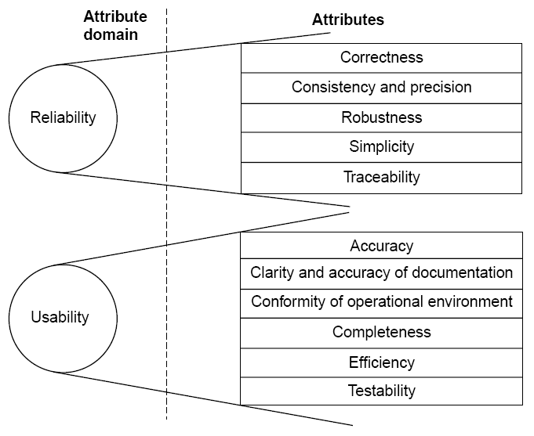
Software
Reliability
25

Slide 26
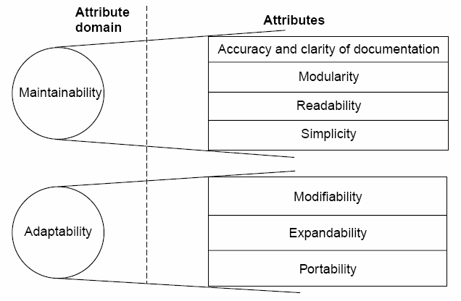
Software
Reliability
Fig 7.8: Software quality attributes
26

Slide 27

Software
Reliability
1
Reliability
The extent to which a software performs its intended functions without failure.
2
Correctness
The extent to which a software meets its specifications.
3
Consistency &
precision
The extent to which a software is consistent and give results with precision.
4
Robustness
The extent to which a software tolerates the unexpected problems.
5
Simplicity
The extent to which a software is simple in its operations.
6
Traceability
The extent to which an error is traceable in order to fix it.
7
Usability
The extent of effort required to learn, operate and understand the functions of the software
27

Slide 28
Software
Reliability
8
Accuracy
Meeting specifications with precision.
9
Clarity & Accuracy of documentation
The extent to which documents are clearly & accurately written.
10
Conformity of operational environment
The extent to which a software is in conformity of operational environment.
11
Completeness
The extent to which a software has specified functions.
12
Efficiency
The amount of computing resources and code required by software to perform a function.
13
Testability
The effort required to test a software to ensure that it performs its intended functions.
14
Maintainability
The effort required to locate and fix an error during maintenance phase.
28

Slide 29
Software
Reliability
15
Modularity
It is the extent of ease to implement, test, debug and maintain the software.
16
Readability
The extent to which a software is readable in order to understand.
17
Adaptability
The extent to which a software is adaptable to new platforms & technologies.
18
Modifiability
The effort required to modify a software during maintenance phase.
19
Expandability
The extent to which a software is expandable without undesirable side effects.
20
Portability
The effort required to transfer a program from one platform to another platform.
Table 7.4: Software quality attributes
29

Slide 30
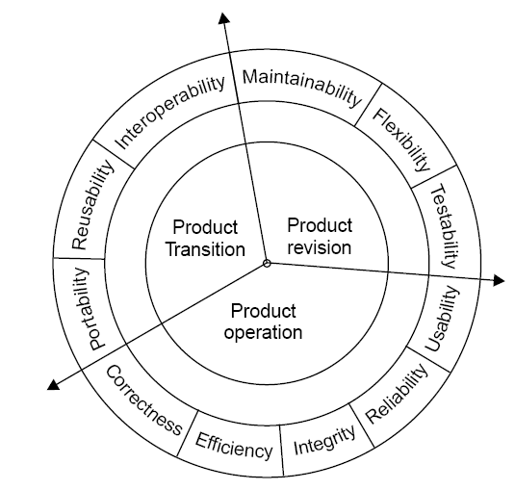
Software Reliability
•
McCall
Software Quality
Model
Fig 7.9: Software quality factors
30

Slide 31
Software
Reliability
i.
Product Operation
Factors
which are
related
to
the
operation
of
a
product
are
combined. The factors
are:
•
•
•
•
•
Correctness
Efficiency
Integrity
Reliability
Usability
five factors
These
are
related
to
operational
performance,
convenience, ease of
usage and its correctness. These factors play
a very significant role in building customer’s satisfaction.
31

Slide 32
Software Reliability
ii.
Product Revision
The
factors
which
are
required
for
testing
&
maintenance
are
combined and are given below:
•
•
•
Maintainability
Flexibility
Testability
These factors pertain to the testing
& maintainability of software.
They give us idea about ease of maintenance, flexibility and testing
effort.
Hence,
they
are
combined
under
the
umbrella
of
product
revision.
32

Slide 33
Software Reliability
iii.
Product Transition
We may have to transfer a product from one platform to an other
platform or from one technology to another technology. The
factors
related to
such a transfer
are
combined
and
given
below:
•
•
•
Portability
Reusability
Interoperability
33

Slide 34
Software Reliability
Most of the quality factors are
explained
in
table
7.4.
The
remaining
factors
are
given
in
table
7.5.
Sr.No.
Quality Factors
Purpose
1
Integrity
The extent to which access to software or data by the unauthorized persons can be controlled.
2
Flexibility
The effort required to modify an operational program.
3
Reusability
The extent to which a program can be reused in other applications.
4
Interoperability
The effort required to couple one system with another.
Table 7.5: Remaining quality factors (other are in table 7.4)
34

Slide 35
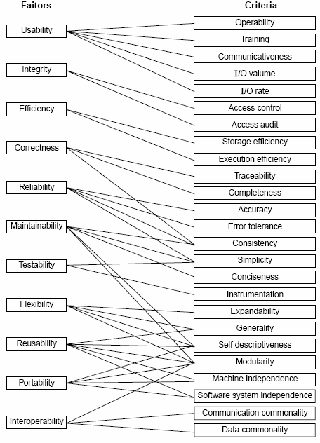
Quality
criteria
Fig 7.10: McCall’s quality model
35

Slide 36
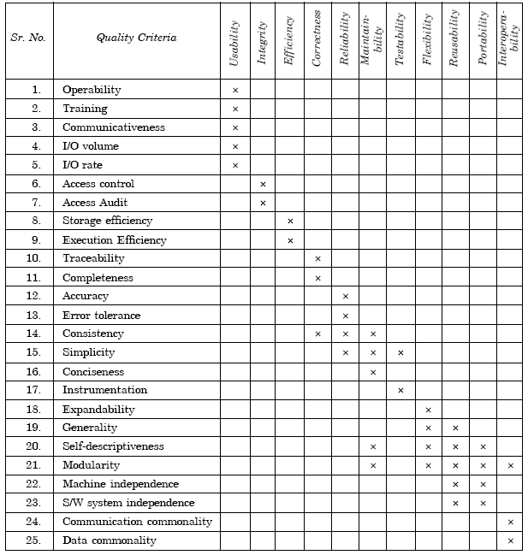
Software
Reliability
Table 7.5(a):
Relation between quality factors and quality criteria
36

Slide 37
Software
Reliability
1
Operability
The ease of operation of the software.
2
Training
The ease with which new users can use the system.
3
Communicativeness
The ease with which inputs and outputs can be assimilated.
4
I/O volume
It is related to the I/O volume.
5
I/O rate
It is the indication of I/O rate.
6
Access control
The provisions for control and protection of the software and data.
7
Access audit
The ease with which software and data can be checked for compliance with standards or other requirements.
8
Storage efficiency
The run time storage requirements of the software.
9
Execution efficiency
The run-time efficiency of the software.
37

Slide 38
Software
Reliability
10
Traceability
The ability to link software components to requirements.
11
Completeness
The degree to which a full implementation of the required functionality has been achieved.
12
Accuracy
The precision of computations and output.
13
Error tolerance
The degree to which continuity of operation is ensured under adverse conditions.
14
Consistency
The use of uniform design and implementation techniques and notations throughout a project.
15
Simplicity
The ease with which the software can be understood.
16
Conciseness
The compactness of the source code, in terms of lines of code.
17
Instrumentation
The degree to which the software provides for measurements of its use or identification of errors.
38

Slide 39
Software
Reliability
18
Expandability
The degree to which storage requirements or software functions can be expanded.
19
Generability
The breadth of the potential application of software components.
20
Self- descriptiveness
The degree to which the documents are self explanatory.
21
Modularity
The provision of highly independent modules.
22
Machine independence
The degree to which software is dependent on its associated hardware.
23
Software system independence
The degree to which software is independent of its environment.
24
Communication commonality
The degree to which standard protocols and interfaces are used.
25
Data commonality
The use of standard data representations.
Table 7.5 (b): Software quality criteria
39

Slide 40
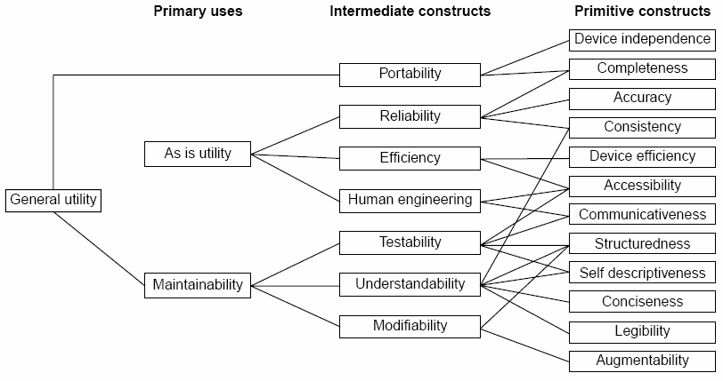
Software Reliability
•
Boehm
Software
Quality
Model
Fig.7.11: The Boehm software quality model
40

Slide 41
Software
Reliability
ISO 9126
•
•
•
•
•
•
Functionality
Reliability
Usability
Efficiency
Maintainability
Portability
41

Slide 42
Software
Reliability
Characteristic/ Attribute
Short Description of the Characteristics and the concerns Addressed by Attributes
Functionality
Characteristics relating to achievement of the basic purpose for which the software is being engineered
• Suitability
The presence and appropriateness of a set of functions for specified tasks
• Accuracy
The provision of right or agreed results or effects
• Interoperability
Software’s ability to interact with specified systems
• Security
Ability to prevent unauthorized access, whether accidental or deliberate, to program and data.
Reliability
Characteristics relating to capability of software to maintain its level of performance under stated conditions for a stated period of time
• Maturity
Attributes of software that bear on the frequency of failure by faults in the software
42

Slide 43
Software
Reliability
• Fault tolerance
Ability to maintain a specified level of performance in cases of software faults or unexpected inputs
• Recoverability
Capability and effort needed to reestablish level of performance and recover affected data after possible failure.
Usability
Characteristics relating to the effort needed for use, and on the individual assessment of such use, by a stated implied set of users.
• Understandability
The effort required for a user to recognize the logical concept and its applicability.
• Learnability
The effort required for a user to learn its application, operation, input and output.
• Operability
The ease of operation and control by users.
Efficiency
Characteristic related to the relationship between the level of performance of the software and the amount of resources used, under stated conditions.
43

Slide 44
Software
Reliability
• Time behavior
The speed of response and processing times and throughout rates in performing its function.
• Resource behavior
The amount of resources used and the duration of such use in performing its function.
Maintainability
Characteristics related to the effort needed to make modifications, including corrections, improvements or adaptation of software to changes in environment, requirements and functions specifications.
• Analyzability
The effort needed for diagnosis of deficiencies or causes of failures, or for identification of parts to be modified.
• Changeability
The effort needed for modification, fault removal or for environmental change.
• Stability
The risk of unexpected effect of modifications.
• Testability
The effort needed for validating the modified software.
44

Slide 45
Software
Reliability
Portability
Characteristics related to the ability to transfer the software from one organization or hardware or software environment to another.
• Adaptability
The opportunity for its adaptation to different specified environments.
• Installability
The effort needed to install the software in a specified environment.
• Conformance
The extent to which it adheres to standards or conventions relating to portability.
• Replaceability
The opportunity and effort of using it in the place of other software in a particular environment.
Table 7.6: Software quality characteristics and attributes – The ISO 9126
view
45

Slide 46
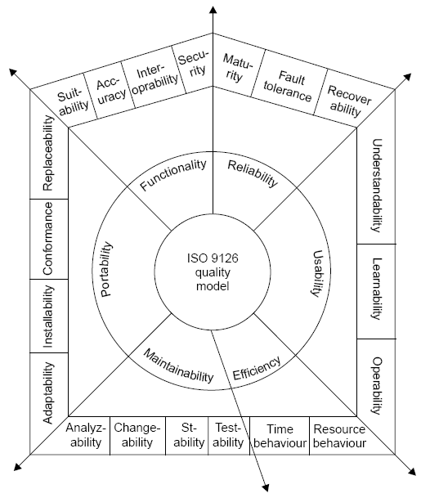
Software
Reliability
Fig.7.12: ISO 9126 quality model
46

Slide 47
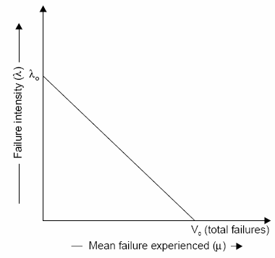
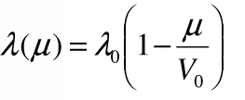
Software Reliability
Software Reliability Models
•
Basic
Execution
Time
Model
(1)
Fig.7.13: Failure intensity λ as a
function of µ for basic model
47

Slide 48
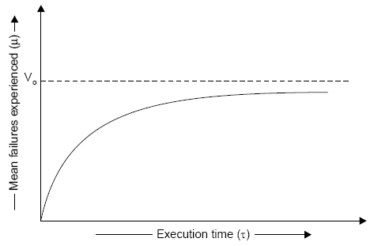
Software
Reliability
dλ
dµ
− λ₀
=
(2)
V₀
Fig.7.14: Relationship between τ
& µ for basic
model
48

Slide 49

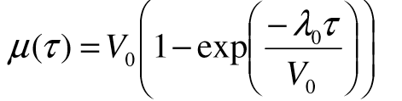
Software Reliability
For a derivation of this relationship, equation 1 can
be written
as:
The
above equation
can
be
solved for
µ(τ )
and
result
in :
(3)
49

Slide 50
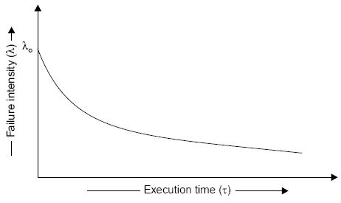
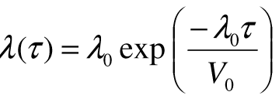
Software Reliability
The failure
intensity
below
as
a
function
of execution
time
is
shown
in
figure
given
Fig.7.15: Failure intensity versus execution time for basic model
50

Slide 51
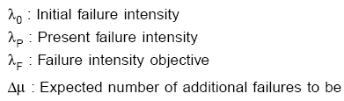
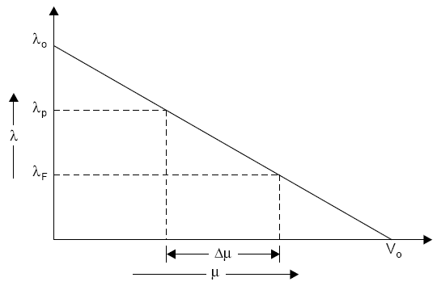
Software
Reliability
•
Derived
quantities
Fig.7.16: Additional failures required to be experienced to reach the
objective
51

Slide 52
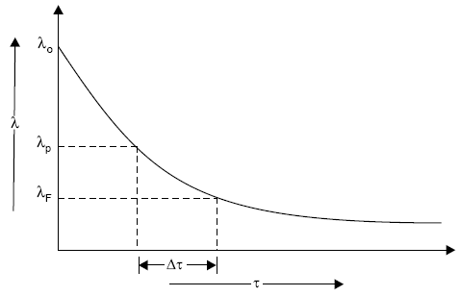
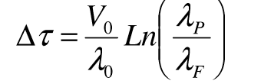
Software
Reliability
Fig.7.17: Additional time required to reach the
objective
This can be derived in mathematical form as:
52

Slide 53
Software Reliability
Example- 7.1
Assume that a program will experience 200 failures in
now experienced 100. The initial failure intensity was 20
infinite time. It has
failures/CPU hr.
(i) Determine the current failure intensity.
(ii) Find the decrement of failure intensity per failure.
(iii) Calculate the failures experienced and failure intensity after 20 and 100
CPU hrs. of execution.
(iv) Compute addition failures and additional execution time required to
reach the failure intensity objective of 5 failures/CPU hr.
Use the basic execution time model for the above mentioned calculations.
53

Slide 54
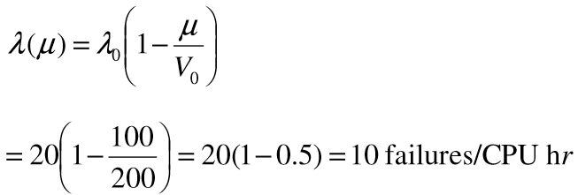
Software Reliability
Solution
Here
Vo=200 failures
µ = 100 failures
λ₀ = 20 failures/CPU hr.
failure intensity:
(i)
Current
54

Slide 55
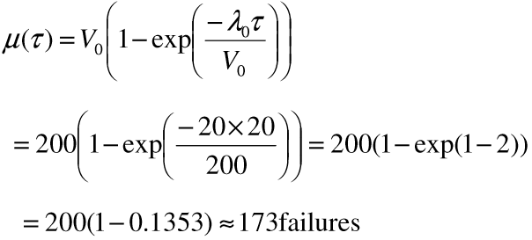
Software Reliability
(ii) Decrement
of failure intensity per failure can be
calculated as:
dλ
dµ
− λ₀
− ²⁰
=
=
= −0.1/ CPU hr.
V₀
200
(iii)
(a)
Failures experienced & failure intensity after 20 CPU
hr:


− λ τ

^{µ (τ ) = V0} ^{1 − exp}


V

−
55

Slide 56
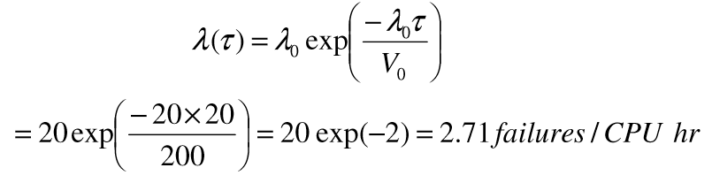
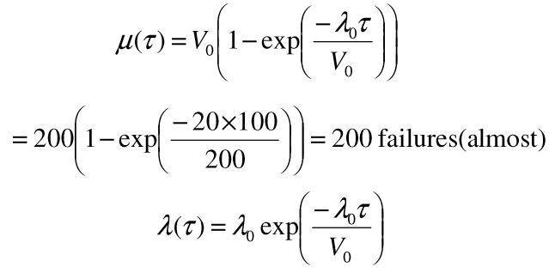
Software
Reliability

− λ τ

λ (τ ) = λ
exp ⁰ 
0

V₀


−
×

=


= 20 exp(−2) = 2.71 failures / CPU hr

200
(b)
Failures experienced & failure
intensity after 100 CPU hr:


− λ τ
 

 ⁰  
^{µ (τ ) = V0} ^{1 − exp}
 


V
0  

−
×
 
= 2001 − exp ²⁰ ¹⁰⁰   = 200 failures(almost)



200
 

− λ τ

λ (τ ) = λ
exp ⁰ 
0

V₀

56

Slide 57
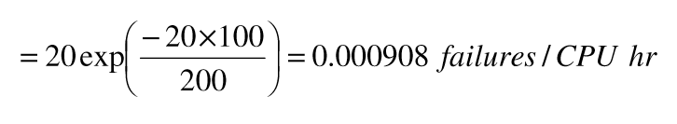

Software Reliability
−
×
20 exp ²⁰ ¹⁰⁰ 


=
= 0.000908 failures / CPU hr

200

(iv) Additional failures
(∆µ )
required to reach the failure intensity
objective
of 5 failures/CPU
hr.
 V 
− λ ) = ²⁰⁰ (10 − 5) = 50 failures
 ⁰ (λ


∆µ =


λ₀

P
F

20

57

Slide 58
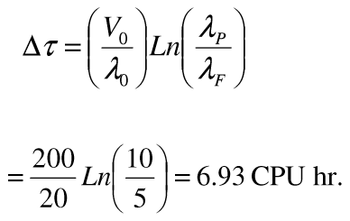
Software Reliability
Additional execution time required to reach
failure
intensity
objective
of
5
failures/CPU
hr.
 V 

λ

∆τ =
 ⁰ Ln ^{P} 

λ₀


λ_{F}

²⁰⁰ Ln ¹⁰ 


=
= 6.93 CPU hr.
20

5

58

Slide 59
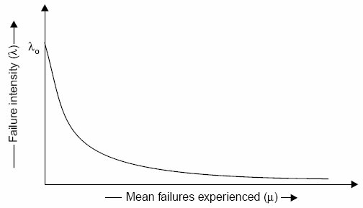

Software Reliability
•
Logarithmic Poisson Execution
Failure Intensity
Time
Model
λ (µ )
= λ₀
exp(−θµ )
Fig.7.18: Relationship between
59

Slide 60
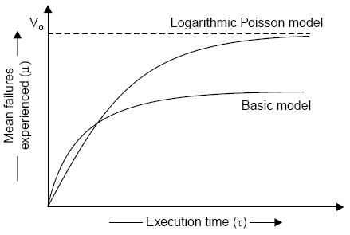
Software
Reliability
dλ
dµ
dλ
= −λ₀θ
exp(−µθ )
= −θλ
dµ
Fig.7.19:
Relationship between
60

Slide 61
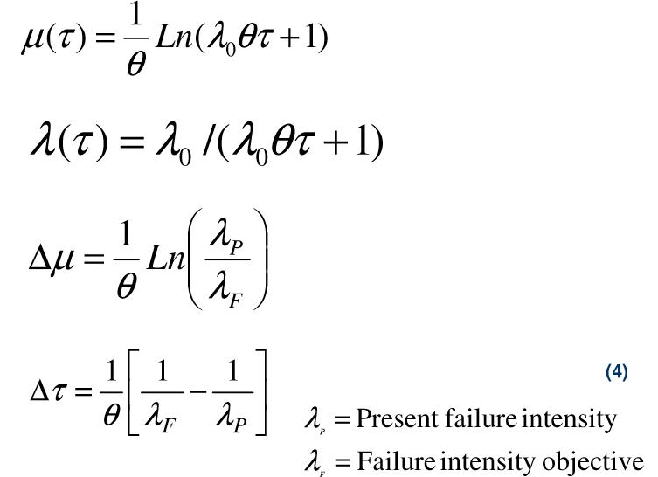
Software Reliability
θ
µ (τ )
=
Ln(λ θτ + 1)
0
λ (τ
) =
λ₀ /(λ₀θτ
+ 1)
1

λ

∆µ =
Ln

P


θ
λ_{F}
1
1

1



(4)
∆τ =

−
θ
 ^{λ}F
λP
λ = Present
P
failure intensity
λ
= Failure intensity objective
F
61

Slide 62
Software Reliability
Example- 7.2
Assume that the initial failure intensity is 20
failures/CPU hr. The failure
intensity
decay
parameter
is
0.02/failures.
We
have experienced
100
failures up to this time.
(i) Determine the current failure intensity.
(ii) Calculate the decrement of failure intensity
per failure.
(iii) Find the failures experienced and failure intensity after 20 and 100 CPU
hrs. of execution.
(iv) Compute the additional failures and additional execution time required to
reach the failure intensity objective of 2 failures/CPU hr.
Use Logarithmic Poisson execution time model for the above mentioned
calculations.
62

Slide 63
Software Reliability
Solution
λ₀
µ
θ
= 20 failures/CPU hr.
= 100 failures
= 0.02 / failures
(i)
Current
failure intensity:
λ (µ ) = λ₀ exp(−θµ )
= 20 exp (-0.02 x 100)
= 2.7 failures/CPU hr.
63

Slide 64
Software Reliability
(ii) Decrement of failure intensity per failure can be
dλ
calculated as:
= −θλ
dµ
= -.02 x 2.7 = -.054/CPU hr.
(iii)
(a)
Failures experienced & failure intensity after 20
CPU
hr:
1
θ
Ln(λ θτ + 1)
µ (τ ) =
0
1
=
Ln(20 × 0.02 × 20 + 1) = 109 failures
0.02
64

Slide 65
Software Reliability
λ (τ ) = λ₀ /(λ₀θτ + 1)
= (20) /(20 × .02 × 20 + 1) = 2.22 failures / CPU hr.
(b)
Failures
experienced & failure intensity after 100 CPU
1
hr:
µ (τ ) =
Ln(λ θτ + 1)
θ
0
1
=
Ln(20 × 0.02 ×100 + 1) = 186 failures
0.02
λ (τ ) = λ₀ /(λ₀θτ + 1)
= (20) /(20 × .02 ×100 + 1) = 0.4878 failures / CPU hr.
65

Slide 66
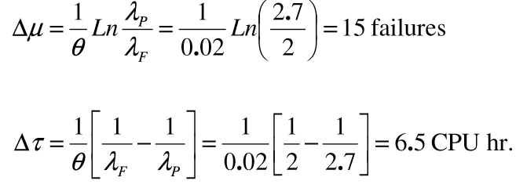
Software Reliability
(iv) Additional failures
(∆µ )
required to reach the failure intensity
objective
of
2 failures/CPU hr.
λ
1

.

1
θ
2 7
∆µ
=
Ln ^{P}
=
Ln



= 15 failures
λ_{F}
0.02
2




1 1

1

1 1

1

∆τ
=
−
=
−
= 6.5 CPU hr.
θ
 λF
λ_{P}

0.02  2
2.7 
66

Slide 67
Software
Reliability
Example- 7.3
The following parameters for basic
given:
and logarithmic Poisson models are
(a) Determine the addition failures and additional execution time required to
reach the failure intensity objective of 5 failures/CPU hr. for both models.
(b) Repeat this for an objective function of 0.5
we start with the initial failure intensity only.
failure/CPU
hr.
Assume that
Basic execution time model
Logarithmic Poisson execution time model
λ = 10 failures/CPU hr
λ = 30 failures/CPU hr
o
o
V = 100 failures
θ = 0.25 / failure
o
67

Slide 68
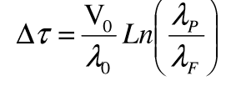
Software Reliability
Solution
(a) (i)
Basic
execution time model
^{V0} (λ
∆µ =
− λ )
λ₀
100
10
P
F
=
(10 − 5) = 50 failures
λ_{P}
(Present failure intensity) in this case is same
as
λ₀
(initial
failure intensity).
Now,
V

λ

∆τ =
⁰ Ln ^{P} 
λ₀

λ_{F}

68

Slide 69

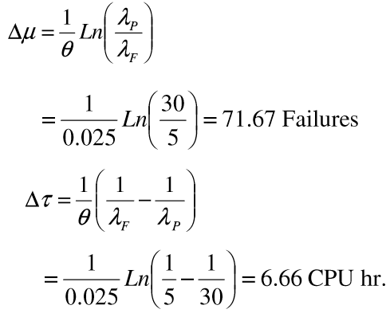
Software Reliability
¹⁰⁰ Ln ¹⁰


=
= 6.93 CPU hr.
10

5

(ii)
Logarithmic execution time model
1

λ

∆µ =
Ln ^{P} 
θ
 λF 
¹ Ln ³⁰ 


=
= 71.67 Failures
0.025

5
1



1 1
∆τ =

−


θ
 λF
λ _{P}
1
Ln ¹ −
¹ 


=
= 6.66 CPU hr.
0.025
 5 30 
69

Slide 70
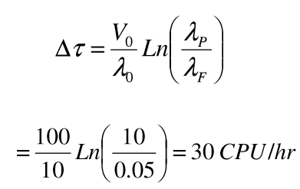
Software Reliability
Logarithmic model has calculated more
execution time initially.
failures in almost some
duration
of
(b) Failure intensity objective
(λ_{F}
)⁼
0.5
failures/CPU hr.
(i) Basic execution
time
model
V₀
(λ_{P}
− λ_{F} )
V₀

λ_{P} 
∆µ =
∆τ =
Ln



λ₀
λ₀
λ_{F}
¹⁰⁰ Ln ¹⁰ 
100
10


=
(10 − 0.5) = 95 failures
=
= 30 CPU /hr
10

0.05
70

Slide 71
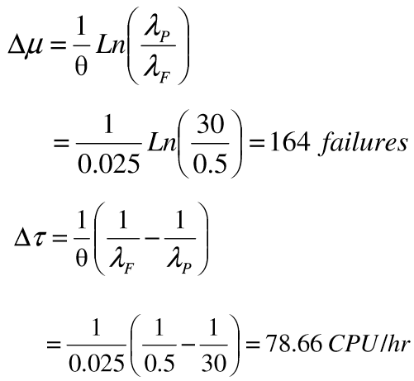
Software Reliability
(ii)
Logarithmic execution time model
1

λ

∆µ
=
Ln ^{P} 
θ

λ_{F}

1
Ln ³⁰


=

= 164 failures
0.025


1
0.5 

1
1
∆τ
=

−


θ λ_{F}
λ_{P}

¹  ¹
¹ 


=
−
= 78.66 CPU /hr
0.025 0.5 30 

71

Slide 72
Software Reliability
•
Calendar Time Component
The calendar time component is based on a debugging process
model.
This model takes into account:
1.
resources
execution failure.
resources
used
in
operating
processing
the
an
program
for
a
given
time
and
associated
quantity
of
2.
quantities
available, and
3.
the
degree to
which a
resource
can be
utilized
(due
to
bottlenecks) during the period in which it is limiting.
Table
7.7 will help
in
visualizing these
different aspects
of
the
resources, and the parameters that result.
72

Slide 73
Software
Reliability
Resource
usage
Usage parameters requirements per
Planned parameters
Resource
CPU hr
Failure
Quantities available
Utilisation
Failure identification personnel
θ_{I}
µ_{I}
P_{I}
1
Failure correction personnel
0
µ_{f}
P_{f}
P_{f}
Computer time
θc
µ_{c}
P_{c}
P_{c}
Fig. : Calendar time component resources and parameters
73

Slide 74
Software Reliability
Hence, to be more precise,
X _{C} = µ_{c} ∆µ + θ_{c} ∆τ
we
have
(for
computer
time)
X
= µ ∆µ
f
f
(for
failure
correction)
X = µ_{I} ∆µ + θ _{I} ∆τ
(for
failure
identification)
I
dx_{T} / dτ = θ_{r} + µ_{r} λ
74

Slide 75
Software Reliability
Calendar time to
execution time relationship
dt / dτ
= (1/ P_{r} p_{r} )dx_{T}
/ dτ
dt / dτ
= (θ_{r}
+ µ_{r} λ ) / P_{r}
p_{r}
75

Slide 76
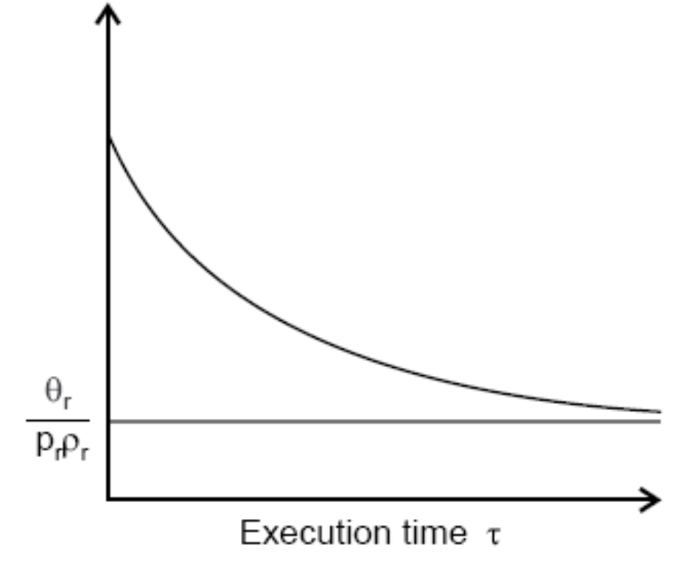
Software
Reliability
Fig.7.20: Instantaneous calendar time to execution time ratio
76

Slide 77
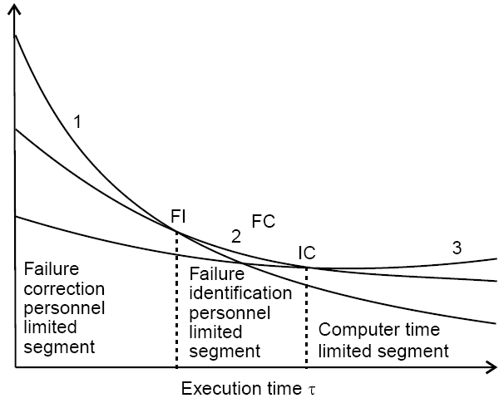
Software
Reliability
Fig.7.21: Calendar time to execution time ratio for different
limiting resources
77

Slide 78
Software Reliability
Example- 7.4
A team run test cases for 10 CPU hrs and identifies 25 failures. The effort
required per hour of execution time is 5 person hr. Each failure
requires 2
hr. on an average to verify and
determine
its
nature.
Calculate
the
failure
identification
effort
required.
78

Slide 79
Software
Reliability
Solution
As we
know, resource usage is:
X _{r} = θ_{r}τ + µ_{r} µ
= 15 person hr.
= 10 CPU hrs.
Here
θ_{r}
τ
µ = 25 failures
µ_{r} = 2 hrs./failure
Hence,
Xr = 5 (10) + 2 (25)
= 50 + 50 = 100 person hr.
79

Slide 80
Software Reliability
Example- 7.5
Initial failure intensity (λ₀ ) for a given software is 20 failures/CPU hr. The
failure
Assume
intensity
^{objective} (λ_{F} )
of
1 failure/CPU
parameters.
hr.
is
to
be
achieved.
the
following
resource
usage
Resource Usage
Per hour
Per failure
Failure identification effort
2 Person hr.
1 Person hr.
Failure Correction effort
0
5 Person hr.
Computer time
1.5 CPU hr.
1 CPU hr.
80

Slide 81
Software Reliability
(a) What
resources must
be
expended to
achieve
the
reliability
improvement? Use the logarithmic Poisson execution time model with a
failure intensity decay parameter of 0.025/failure.
(b) If the failure intensity objective
is
cut
to
half,
what
is
the
effect
on
requirement
of
resources
?
81

Slide 82
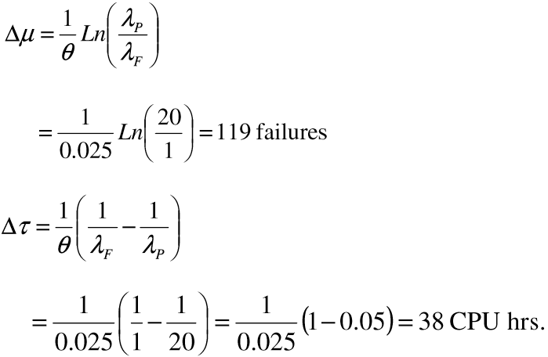
Software
Reliability
Solution
(a)
1
θ

λ_{P} 
∆µ
=
Ln

λ
 F 
1

²⁰ 

=
Ln

= 119 failures
0.025
1

1

1
1

∆τ
=

−


θ λ_{F}
λ_{P}

¹  ¹
¹ 
= ¹ (1 − 0.05) = 38 CPU hrs.


=
−
0.025 1 20
0.025


82

Slide 83
Software Reliability
Hence
X₁ = µ₁∆µ + θ₁∆τ
= 1 (119) + 2 (38) = 195 Person
hrs.
X _{F} = µ_{F} ∆µ
= 5 (119) = 595 Person hrs.
X _{C} = µ_{c} ∆µ + θ_{c} ∆τ
= 1 (119) + (1.5) (38) = 176 CPU hr.
83

Slide 84
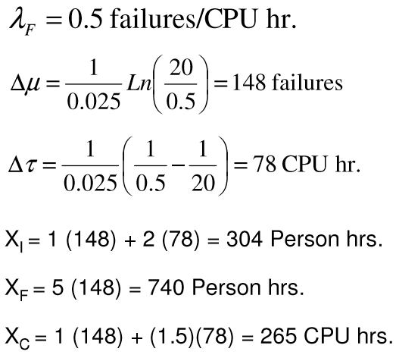
Software Reliability
(b)
λ_{F} = 0.5 failures/CPU hr.
¹ Ln ²⁰


∆µ =

= 148 failures
0.025

0.5 
¹  ¹
¹ 


∆τ =
−
= 78 CPU hr.
0.025  0.5 20 
So,
XI = 1 (148) + 2 (78) = 304 Person hrs.
X_{F} = 5 (148) = 740 Person hrs.
X_{C} = 1 (148) + (1.5)(78) = 265 CPU hrs.
84

Slide 85
Software Reliability
Hence, if we cut failure intensity objective to half, resources
requirements
are
not
doubled
but they
are
some
what
less.
Note
that
∆τ
is
approximately doubled but increases logarithmically.
Thus, the resources
increase
changes
will be between a logarithmic
increase
and
a
linear
increase
for
in
failure
intensity
objective.
85

Slide 86
Software Reliability
Example- 7.6
A program is expected to have 500 faults. It is also assumed that one fault
may lead to one failure only. The initial failure intensity was 2 failures/CPU
hr. The program was to be released with a failure intensity objective of 5
failures/100
release.
CPU
hr.
Calculated
the
number
of
failure
experienced
before
86

Slide 87
Software Reliability
Solution
The number of failure experienced during
the equation mentioned below:
testing can
be calculated
using
V₀
(λ_{P} − λ_{F} )
∆µ =
λ₀
Here
V0 = 500 because one fault leads to one failure
λ₀ = 2 failures/CPU hr.
λ_{F} = 5 failures/100 CPU hr.
= 0.05 failures/CPU hr.
87

Slide 88
Software Reliability
500
2
(2 − 0.05)
So
∆µ =
= 487 failures
Hence 13 faults are expected
the software.
to remain
at the
release
instant
of
88

Slide 89
Software Reliability
•
The Jelinski-Moranda Model
λ (t ) = φ ( N − i + 1)
where
φ
N I
= Constant of proportionality
= Total number of errors present
= number of errors found by time
interval ti
89

Slide 90
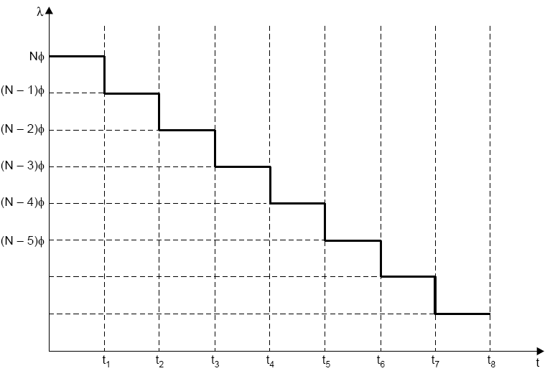
Software
Reliability
Fig.7.22: Relation between t & λ
90

Slide 91
Software Reliability
Example- 7.7
There are 100 errors estimated to be present in a program. We have
experienced
60
errors.
Use Jelinski-Moranda
model
to
calculate
failure intensity with a given value of φ=0.03.
What
will
be
failure
intensity
after
the
experience
of
80
errors?
91

Slide 92
Software Reliability
Solution
N = 100 errors
i = 60 failures
φ = 0.03
λ ( t ) = 0 . 03 (100
= 0.03(100-60+1)
We know
− 60 + 1)
= 1.23 failures/CPU hr.
After 80 failures
λ (t ) = 0.03(100 − 80 + 1)
= 0.63 failures/CPU hr.
Hence, there is continuous decrease in the failure intensity as the
number of failure experienced increases.
92

Slide 93
Software Reliability
•
The Bug Seeding Model
The
bug seeding model is an outgrowth of a
technique
used to
estimate
pond.
the
number
of
animals in a wild life
population
or
fish
in
a
N_{t}
n_{t}
=
N + N_{t}
∧
N =
n + n_{t}
n
N_{t}
n_{t}
n
N =
N _{s}
n_{s}
93

Slide 94
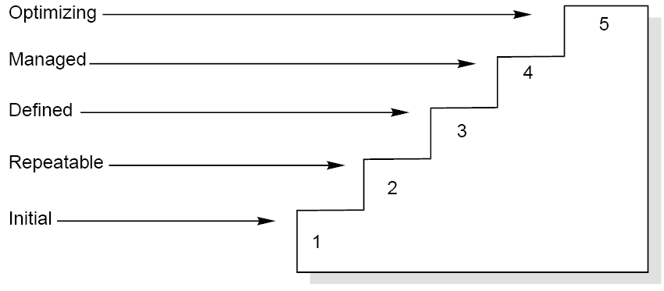
Software Reliability
•
Capability Maturity Model
It is a strategy for improving the
software
process,
irrespective
of
the
actual
life
cycle
model
used.
Fig.7.23: Maturity levels of CMM
94

Slide 95
Software Reliability
Maturity
Levels:
Initial (Maturity Level 1)
Repeatable (Maturity Level 2)
Defined (Maturity Level 3)
Managed (Maturity Level 4)
Optimizing (Maturity Level 5)
95

Slide 96
Software
Reliability
Maturity Level
Characterization
Initial
Adhoc Process
Repeatable
Basic Project Management
Defined
Process Definition
Managed
Process Measurement
Optimizing
Process Control
Fig.7.24: The five levels of CMM
96

Slide 97
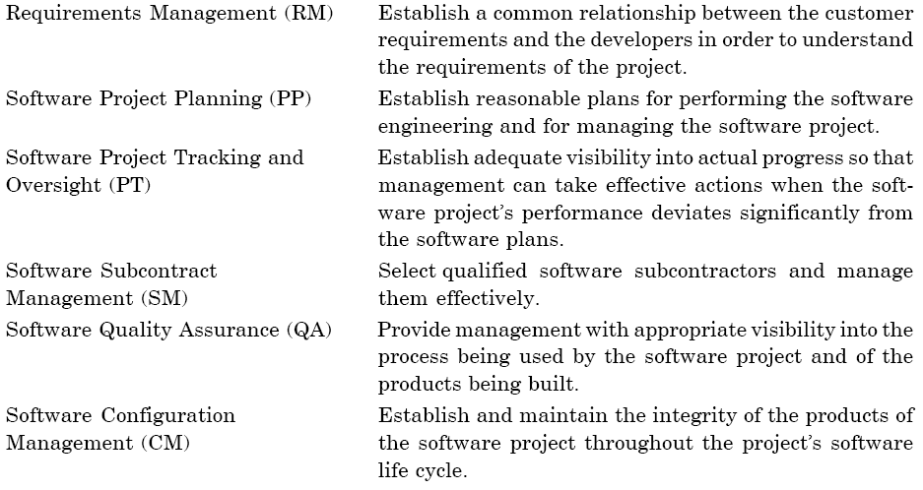
Software Reliability
•
Key Process Areas
The key process areas at level 2 focus on
the software
management
project’s
controls,
concerns related to establishing
basic
project
as
summarized
below:
97

Slide 98
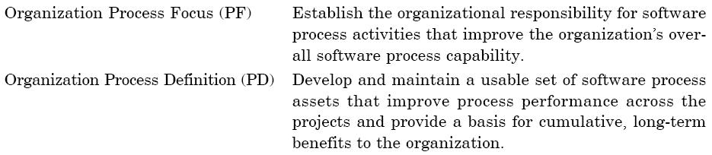
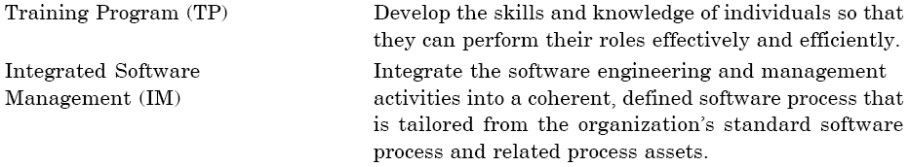
Software Reliability
The
key
process
areas
at
level
3
address
both
project
and
organizational
issues,
as
summarized
below:
98

Slide 99
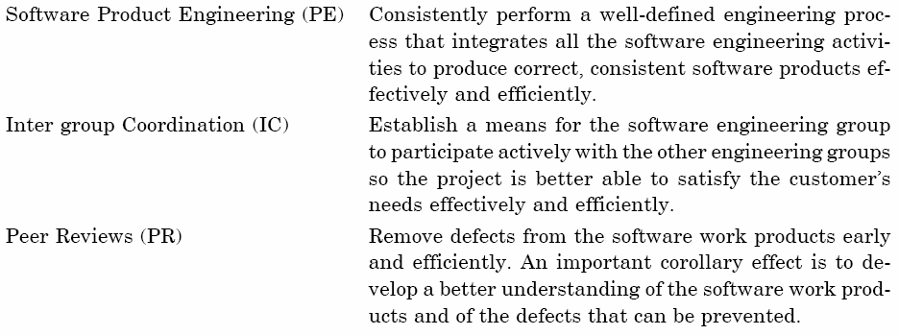
Software
Reliability
99

Slide 100
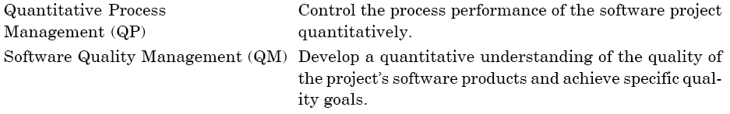
Software Reliability
The key process areas at level 4 focus on establishing a quantitative
understanding of both the software
process
below:
and
the
software
work
products
being
built,
as
summarized
100

Slide 101
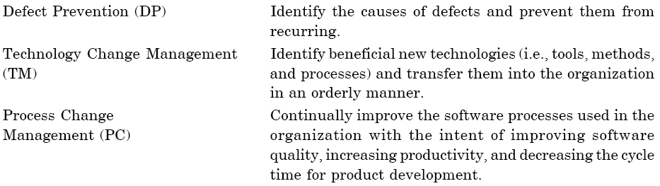
Software Reliability
The key process areas at level 5 cover the issues that both the
organization and the projects must address to implement continuous
and
measurable
software
process
improvement,
as
summarized
below:
101

Slide 102

Software
Reliability
•
Common
Features
102

Slide 103
Software Reliability
•
ISO 9000
The SEI capability maturity model initiative is an
attempt to improve
software
quality by
improving the process
by
which
software
is
developed.
ISO-9000
series
of
standards
is
a
set
of
document
dealing
with
quality systems that
can be used for quality assurance purposes.
ISO-9000 series is not just software standard. It is a series of five
related standards that are applicable to a wide variety of industrial
activities,
including
design/
development,
production,
installation,
and servicing. Within the ISO 9000 Series, standard ISO 9001 for
quality system is the standard that is most applicable to software development.
103

Slide 104
Software Reliability
•
Mapping ISO 9001 to the CMM
1.
2.
Management responsibility
Quality system
3.
Contract review
4.
5.
6.
7.
Design control
Document control
Purchasing
Purchaser-supplied
product
104

Slide 105
Software Reliability
8.
9.
Product identification and traceability
Process control
10.
Inspection and testing
11.
12.
13.
14.
Inspection, measuring and
Inspection and test status
Control of nonconforming
Corrective action
test equipment
product
105

Slide 106
Software Reliability
15.
16.
Handling, storage, packaging
Quality records
and
delivery
17.
Internal quality
audits
18.
19.
20.
Training
Servicing
Statistical
techniques
106

Slide 107
Software Reliability
•
Contrasting ISO 9001 and the CMM
There
is a
strong
correlation
between
ISO
9001
and the
CMM,
although some issues in ISO 9001 are not covered in the CMM, and
some issues in the CMM are not addressed in ISO 9001.
The biggest difference, however, between these two documents is
the emphasis of the CMM on continuous process improvement.
The biggest similarity is that for both the CMM and ISO 9001, the
bottom line is “Say what you do; do what you say”.
107

Slide 108
Reference
Software Engineering -KK Aggarwal and Yogesh Singh.
Software Engineering: A Practitioner's Approach- Roger S. Pressman

